Slide 1
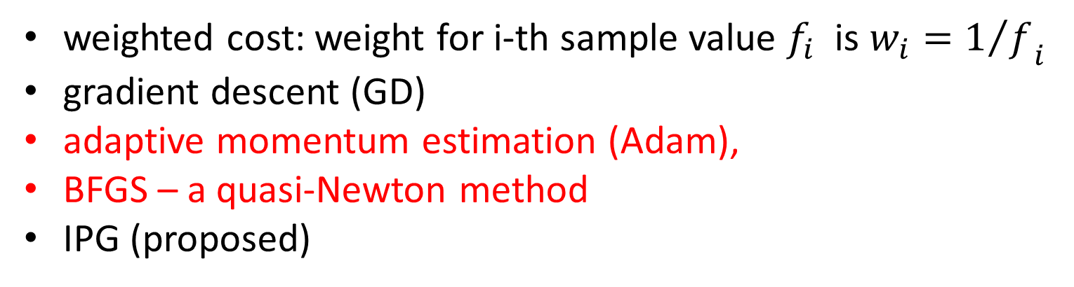
Power (dB) Pattern for Different Algorithms with Weighted Cost
weighted cost: weight for i-th sample value $f_{i}$ is ${w_{i}=1/f}_{i}$
gradient descent (GD)
adaptive momentum estimation (Adam),
BFGS – a quasi-Newton method
IPG (proposed)

Slide 2
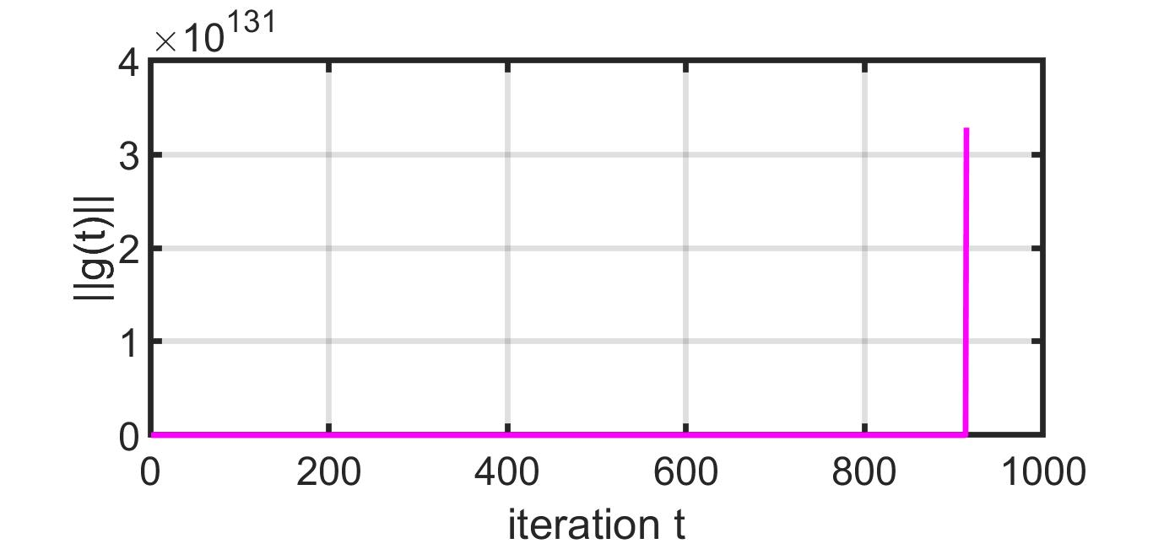
BFGS

Slide 3
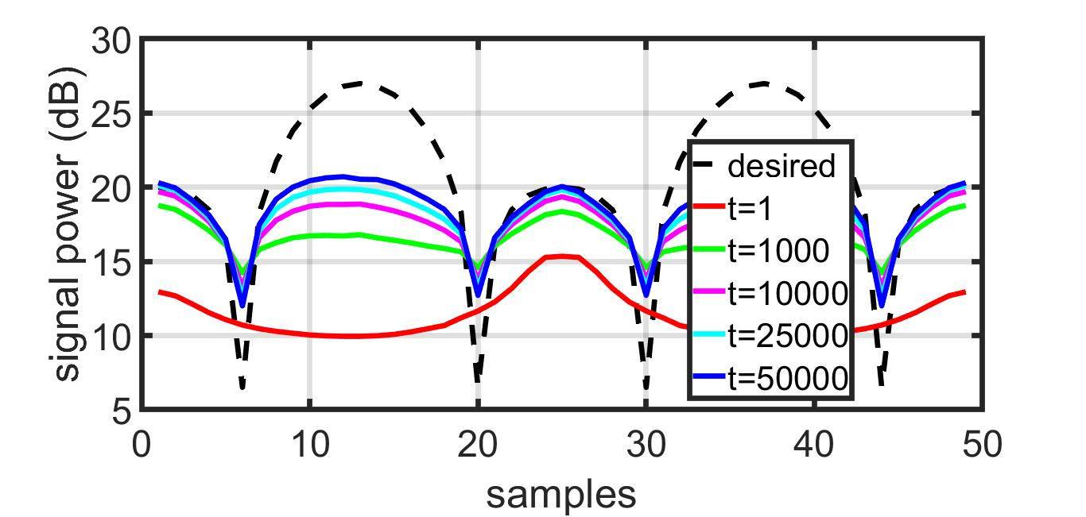
GD: Pattern

Slide 4
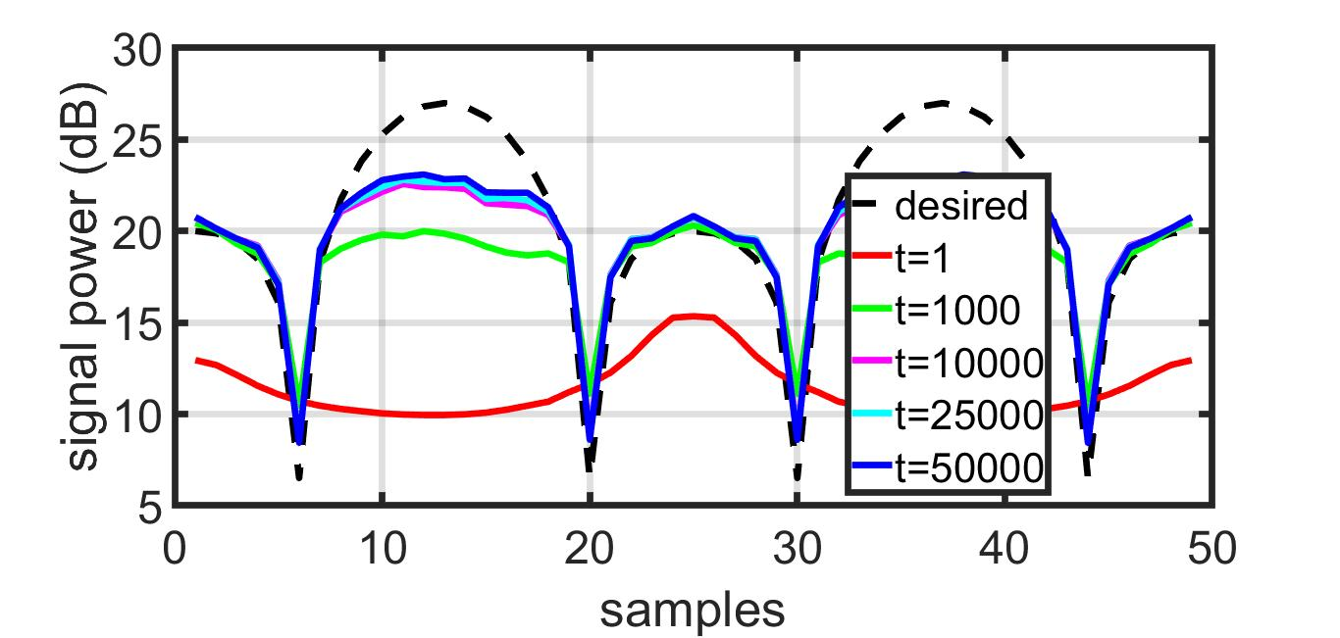
Adam: Pattern

Slide 5
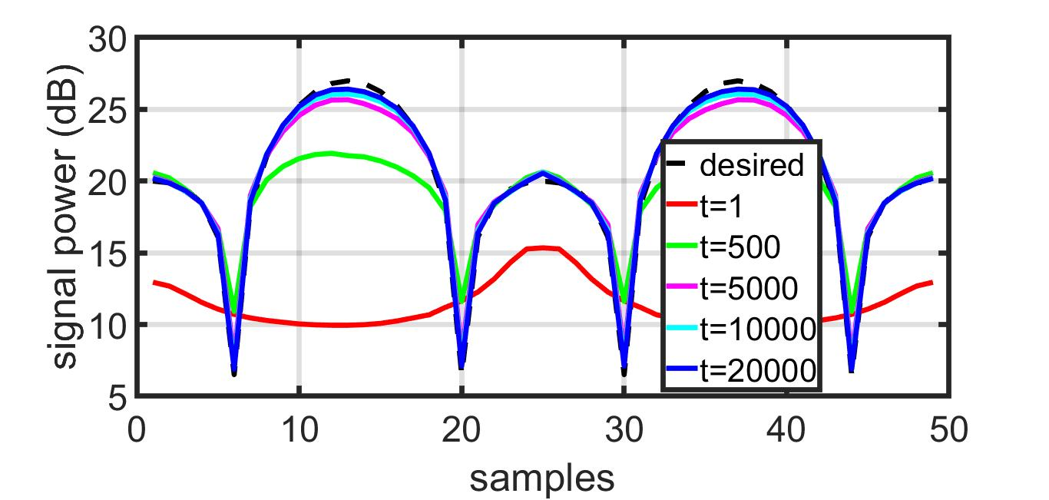
IPG: Pattern

